Slide 1
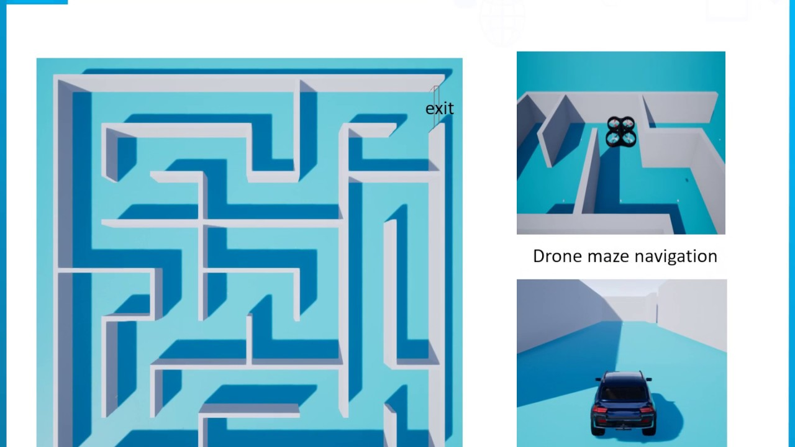

ML CA-1
Model-Free vs. Model-Based Reinforcement Learning: A Comparative Study
Understanding the Core Differences and Applications
Name: Krunal H Dhapodkar
PRN: 22070521006
Semester: 7
Section: A
Mentor: Dr. Harshala Singhne

Slide 2

Sr. | Topic
1. | Introduction to Reinforcement Learning
2. | What is Model Based Reinforcement Learning
3. | What is Model Free Reinforcement Learning
4. | Key Differences
5. | Model Based RL: How it Works
6. | Model Free RL: How it Works
7. | Strengths and Weaknesses
8. | Real-World Applications
9. | Conclusion and Future Directions

Slide 3
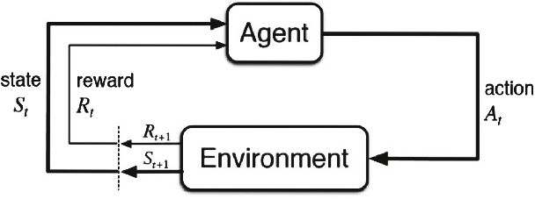
Introduction to Reinforcement Learning (RL)
Reinforcement Learning:
An agent learns to make decisions by interacting with an environment.
Key components:
Agent, Environment, State, Action, Reward.
Goal:
Maximize cumulative reward over time.
The RL Cycle: Learning through trial and error.

Slide 4
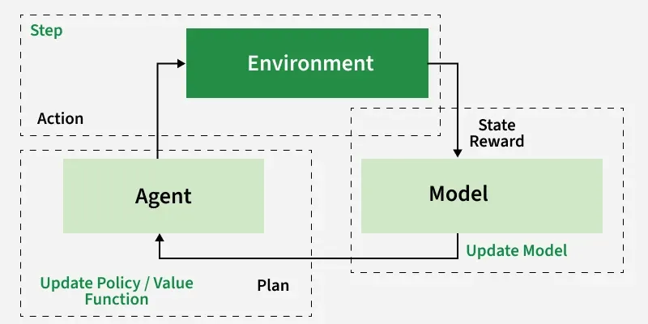
What is Model Based RL
Model-Based RL:
The agent builds a model of the environment (transition and reward functions).
Uses the model to plan actions by predicting future states and rewards.
Example: Chess-playing AI planning moves based on a game model.
Fig: Model-Based RL, Planning with an internal model.

Slide 5
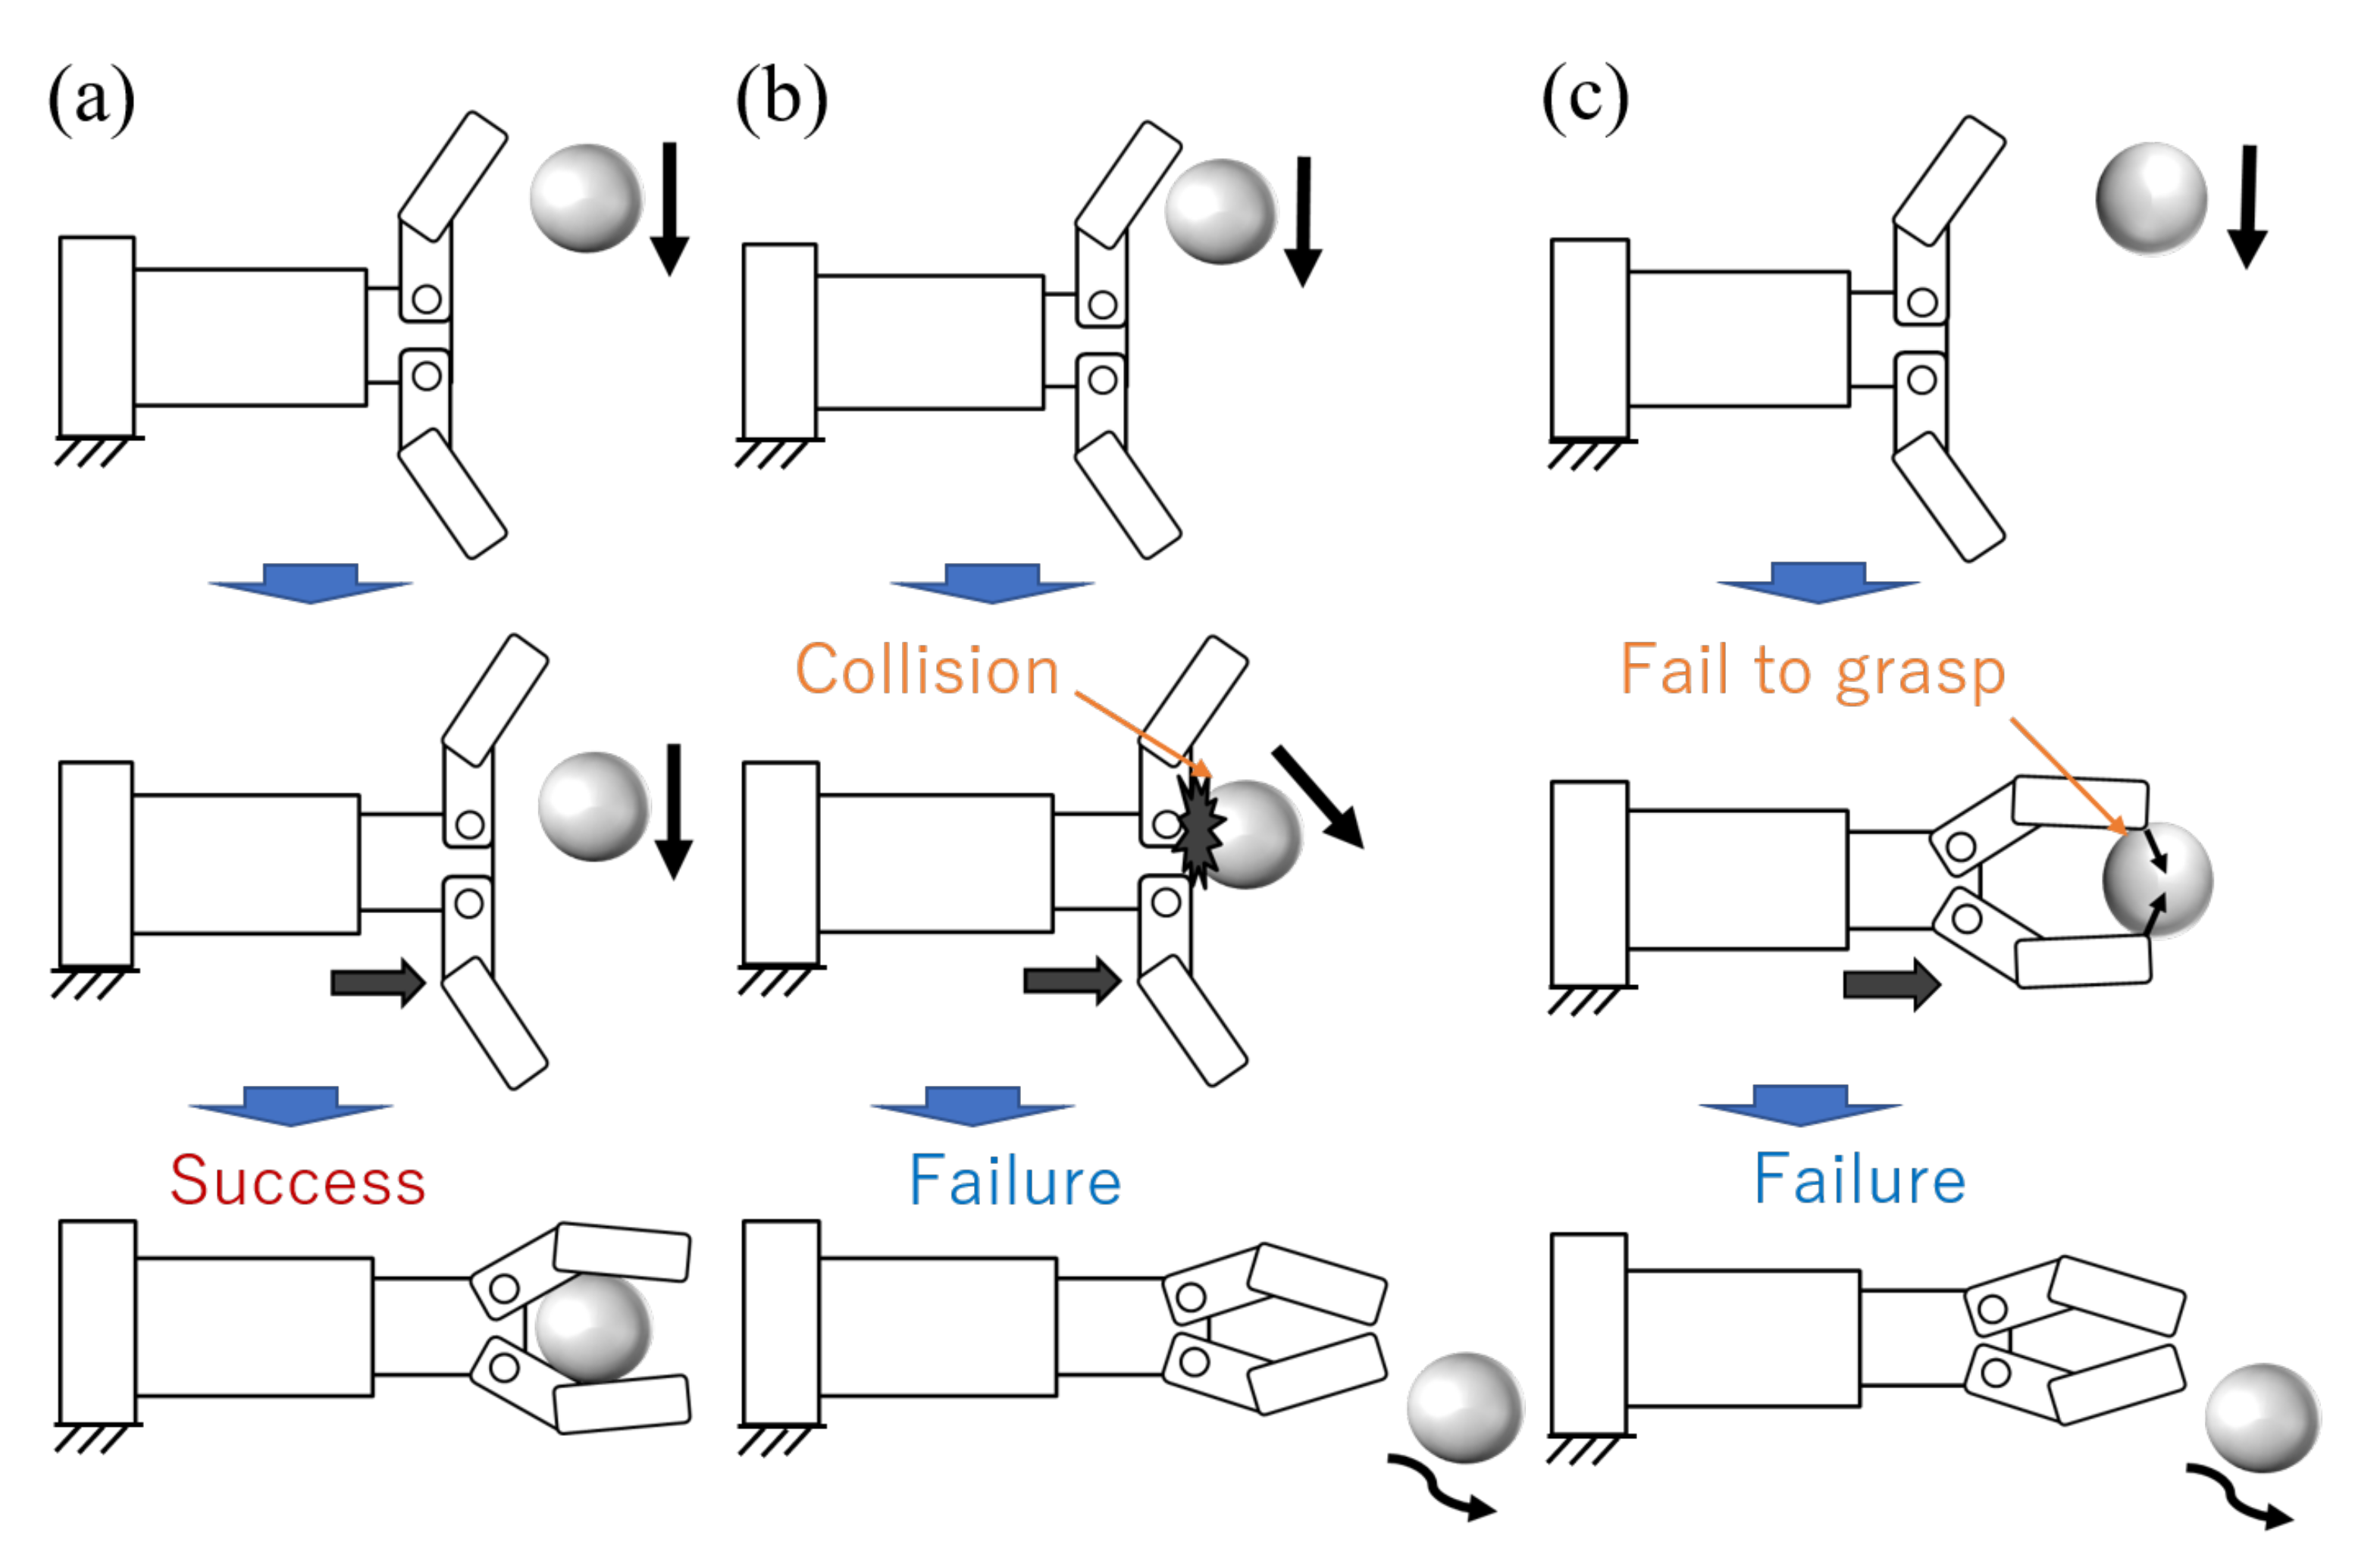
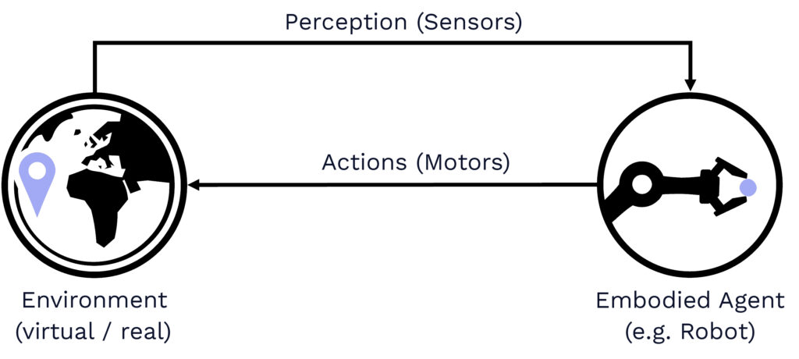
What is Model Free RL
Model-Free RL:
The agent learns directly from experience without modeling the environment.
Relies on trial-and-error to learn policies or value functions.
Example:
A robot learning to hold object by trying different movements.
Model-Free RL: Learning through direct experience.

Slide 6
Key Differences
Model-Based: Learns environment model, plans actions. Model-Free: Learns policies/values directly from experience.
Aspect | Model-Based RL | Model-Free RL
Environment Model | Builds and uses a model | No model, direct learning
Data Efficiency | More efficient | Less efficient
Computational Cost | Higher (planning) | Lower (no planning)
Learning Speed | Faster with good model | Slower, needs more data
Fig: Comparing the core attributes of both approaches.

Slide 7
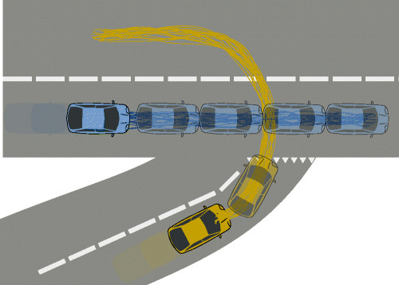
Model Based RL: How it Works
Steps:
Collect data (states, actions, rewards).
Learn a model of the environment (e.g., transition probabilities).
Use the model to plan (e.g., via dynamic programming or simulation).
Fig: Model-Based RL in Action: Planning with predictions.

Slide 8
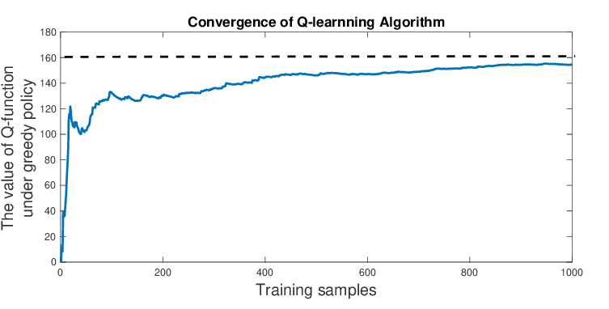
Model Based RL: How it Works
Types:
Value-based (e.g., Q-Learning), Policy-based (e.g., REINFORCE).
Steps:
Interact with the environment.
Update value function or policy based on rewards.
Example:
Game-playing AI learning optimal moves via Q-Learning.
Fig: Model-Free RL: Learning optimal actions through iteration.

Slide 9
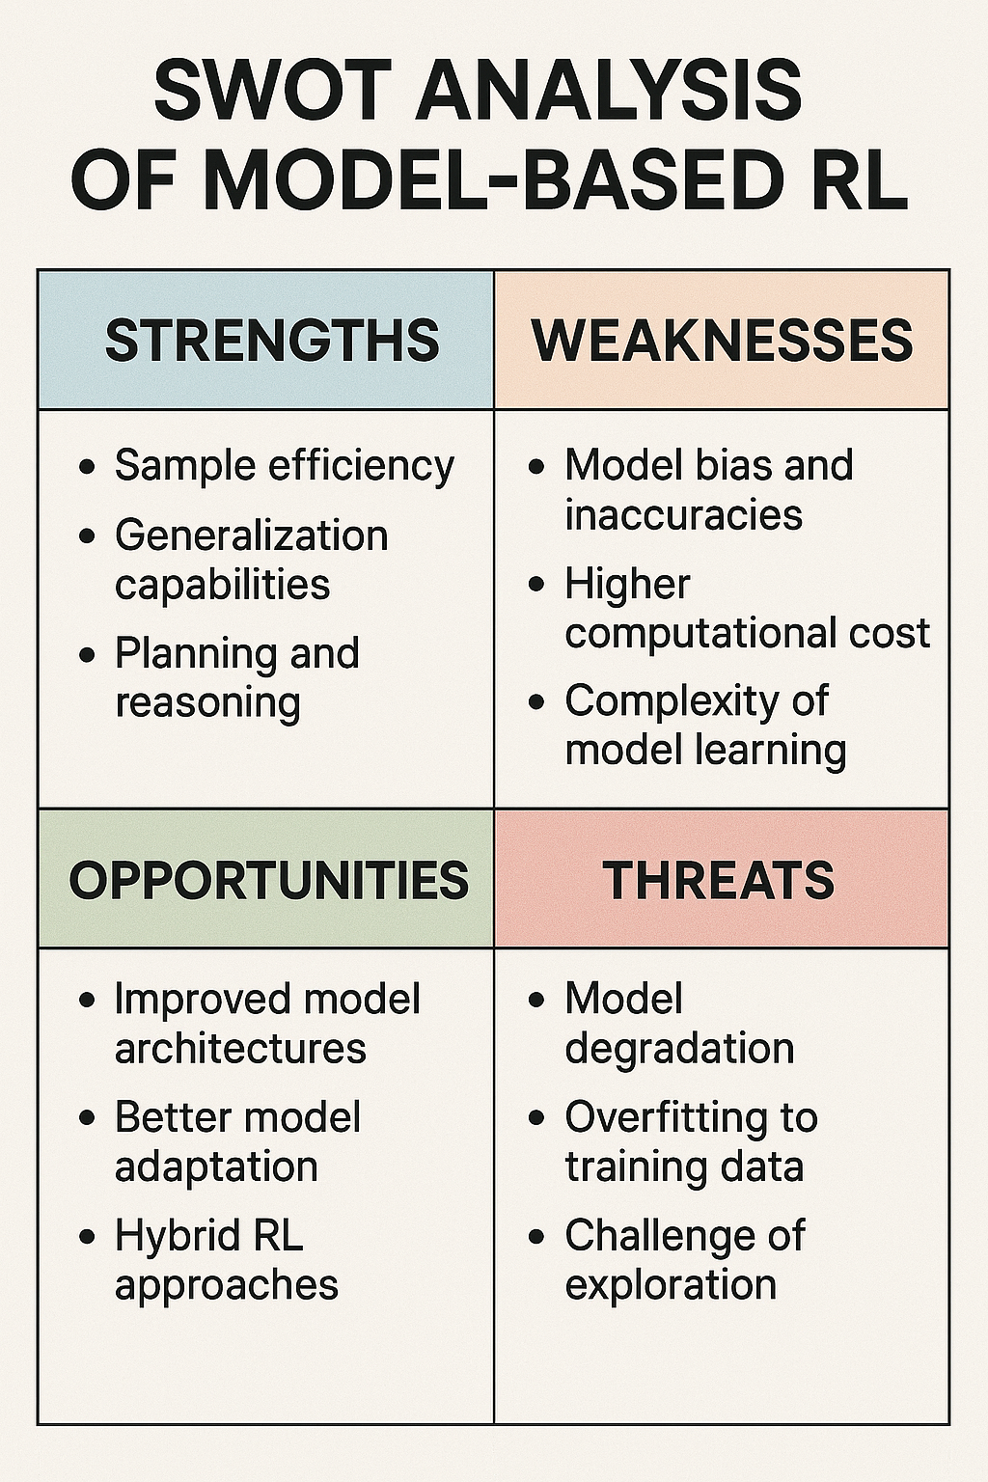
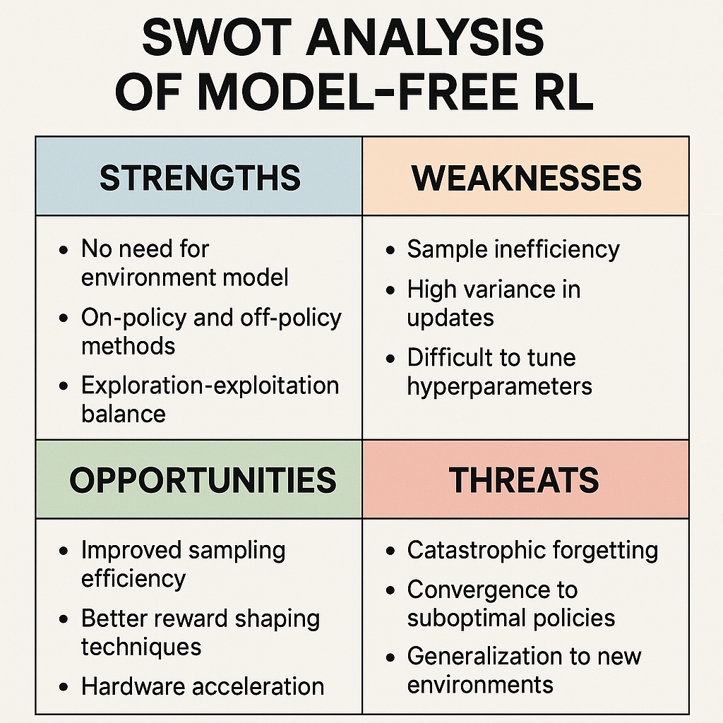
Strenghts and Weaknesses
Model-Based:
Strengths: Data-efficient, effective in predictable environments.
Weaknesses: Model errors, high computational cost.
Model-Free:
Strengths: Simple, robust to complex environments.
Weaknesses: Data-hungry, slower convergence.
Fig: SWOT analysis of both Model-Free and Model-Based RL

Slide 10
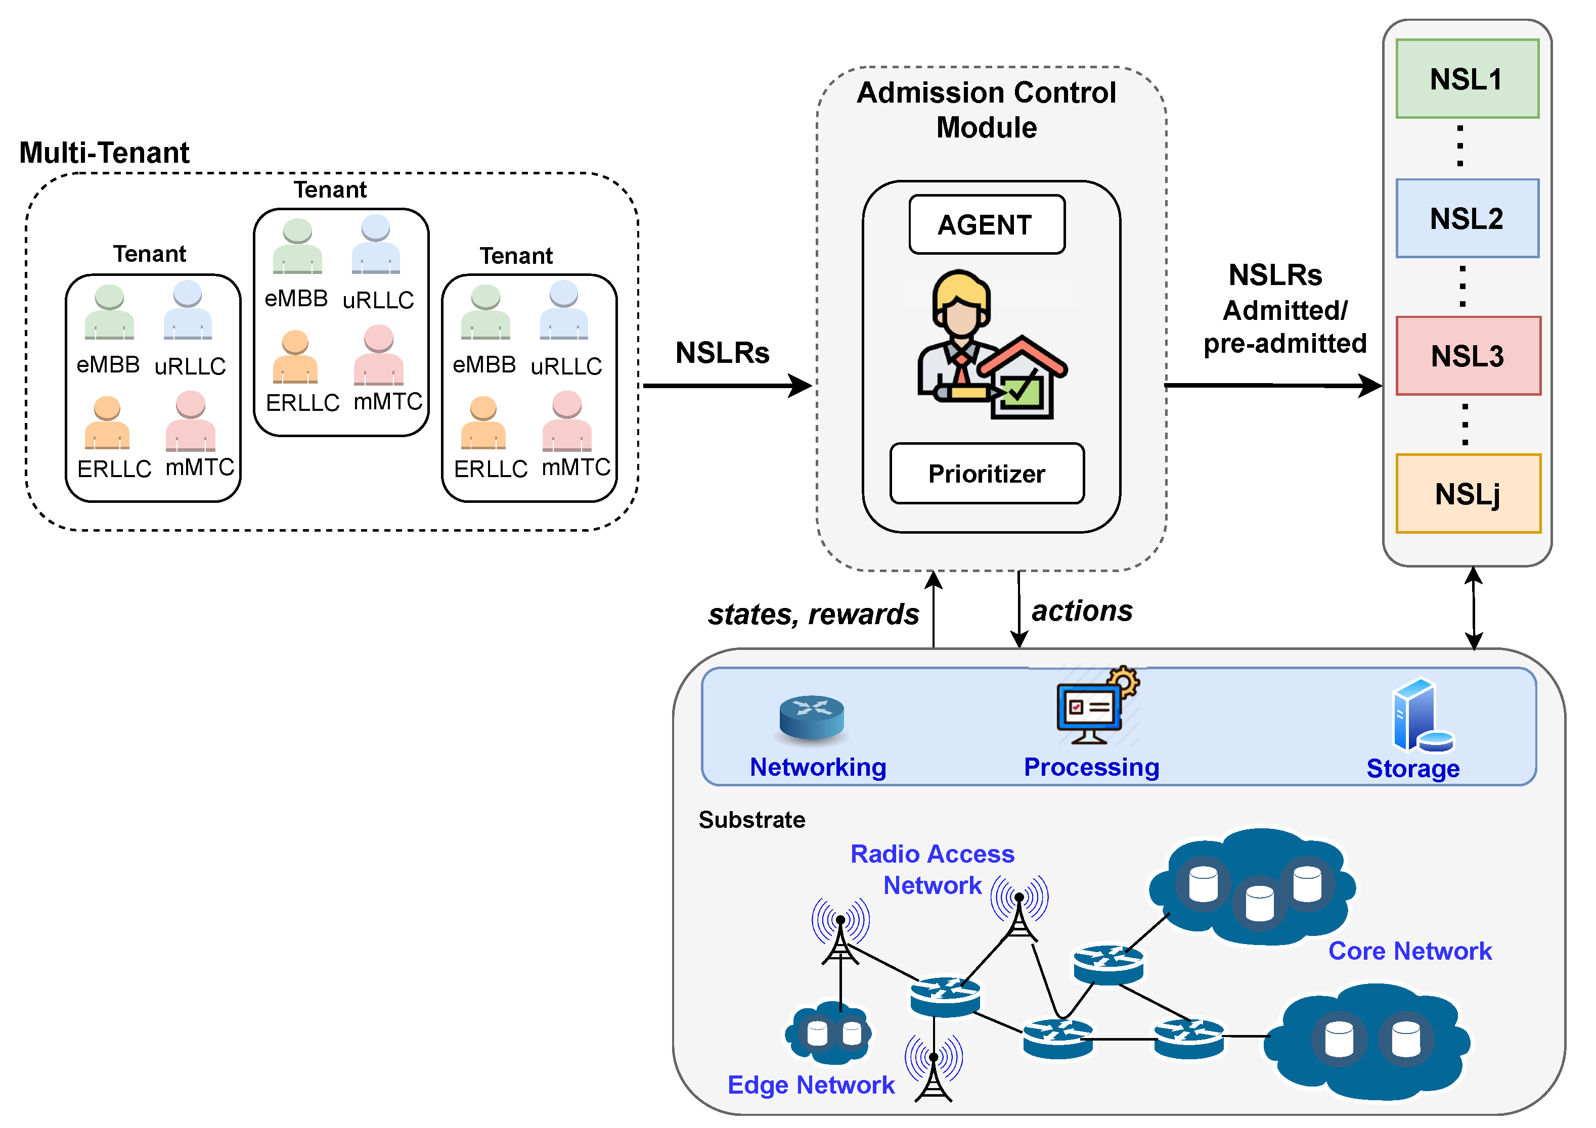
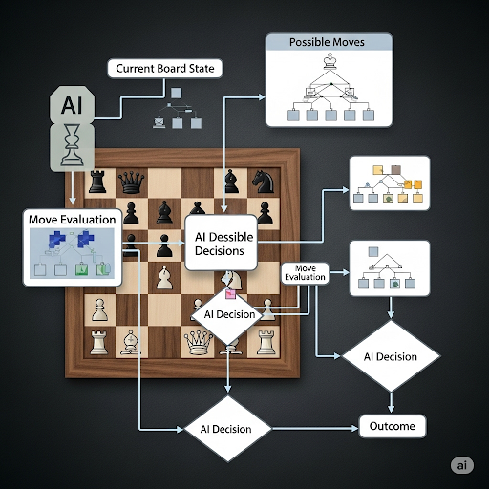
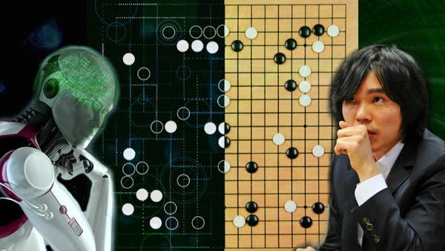
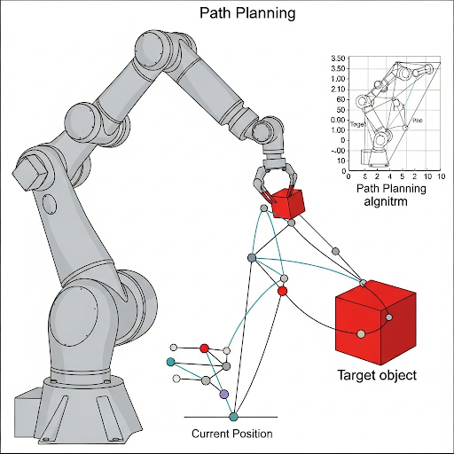
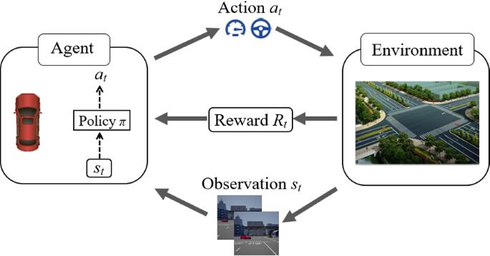
Real-World Applications
Model-Based: Robotics (motion planning), autonomous driving, resource management.
Model-Free: Game AI (AlphaGo), recommendation systems, stock trading.
Scenario: Model-Based in robotics for precise control; Model-Free in gaming for adaptive strategies.

Slide 11
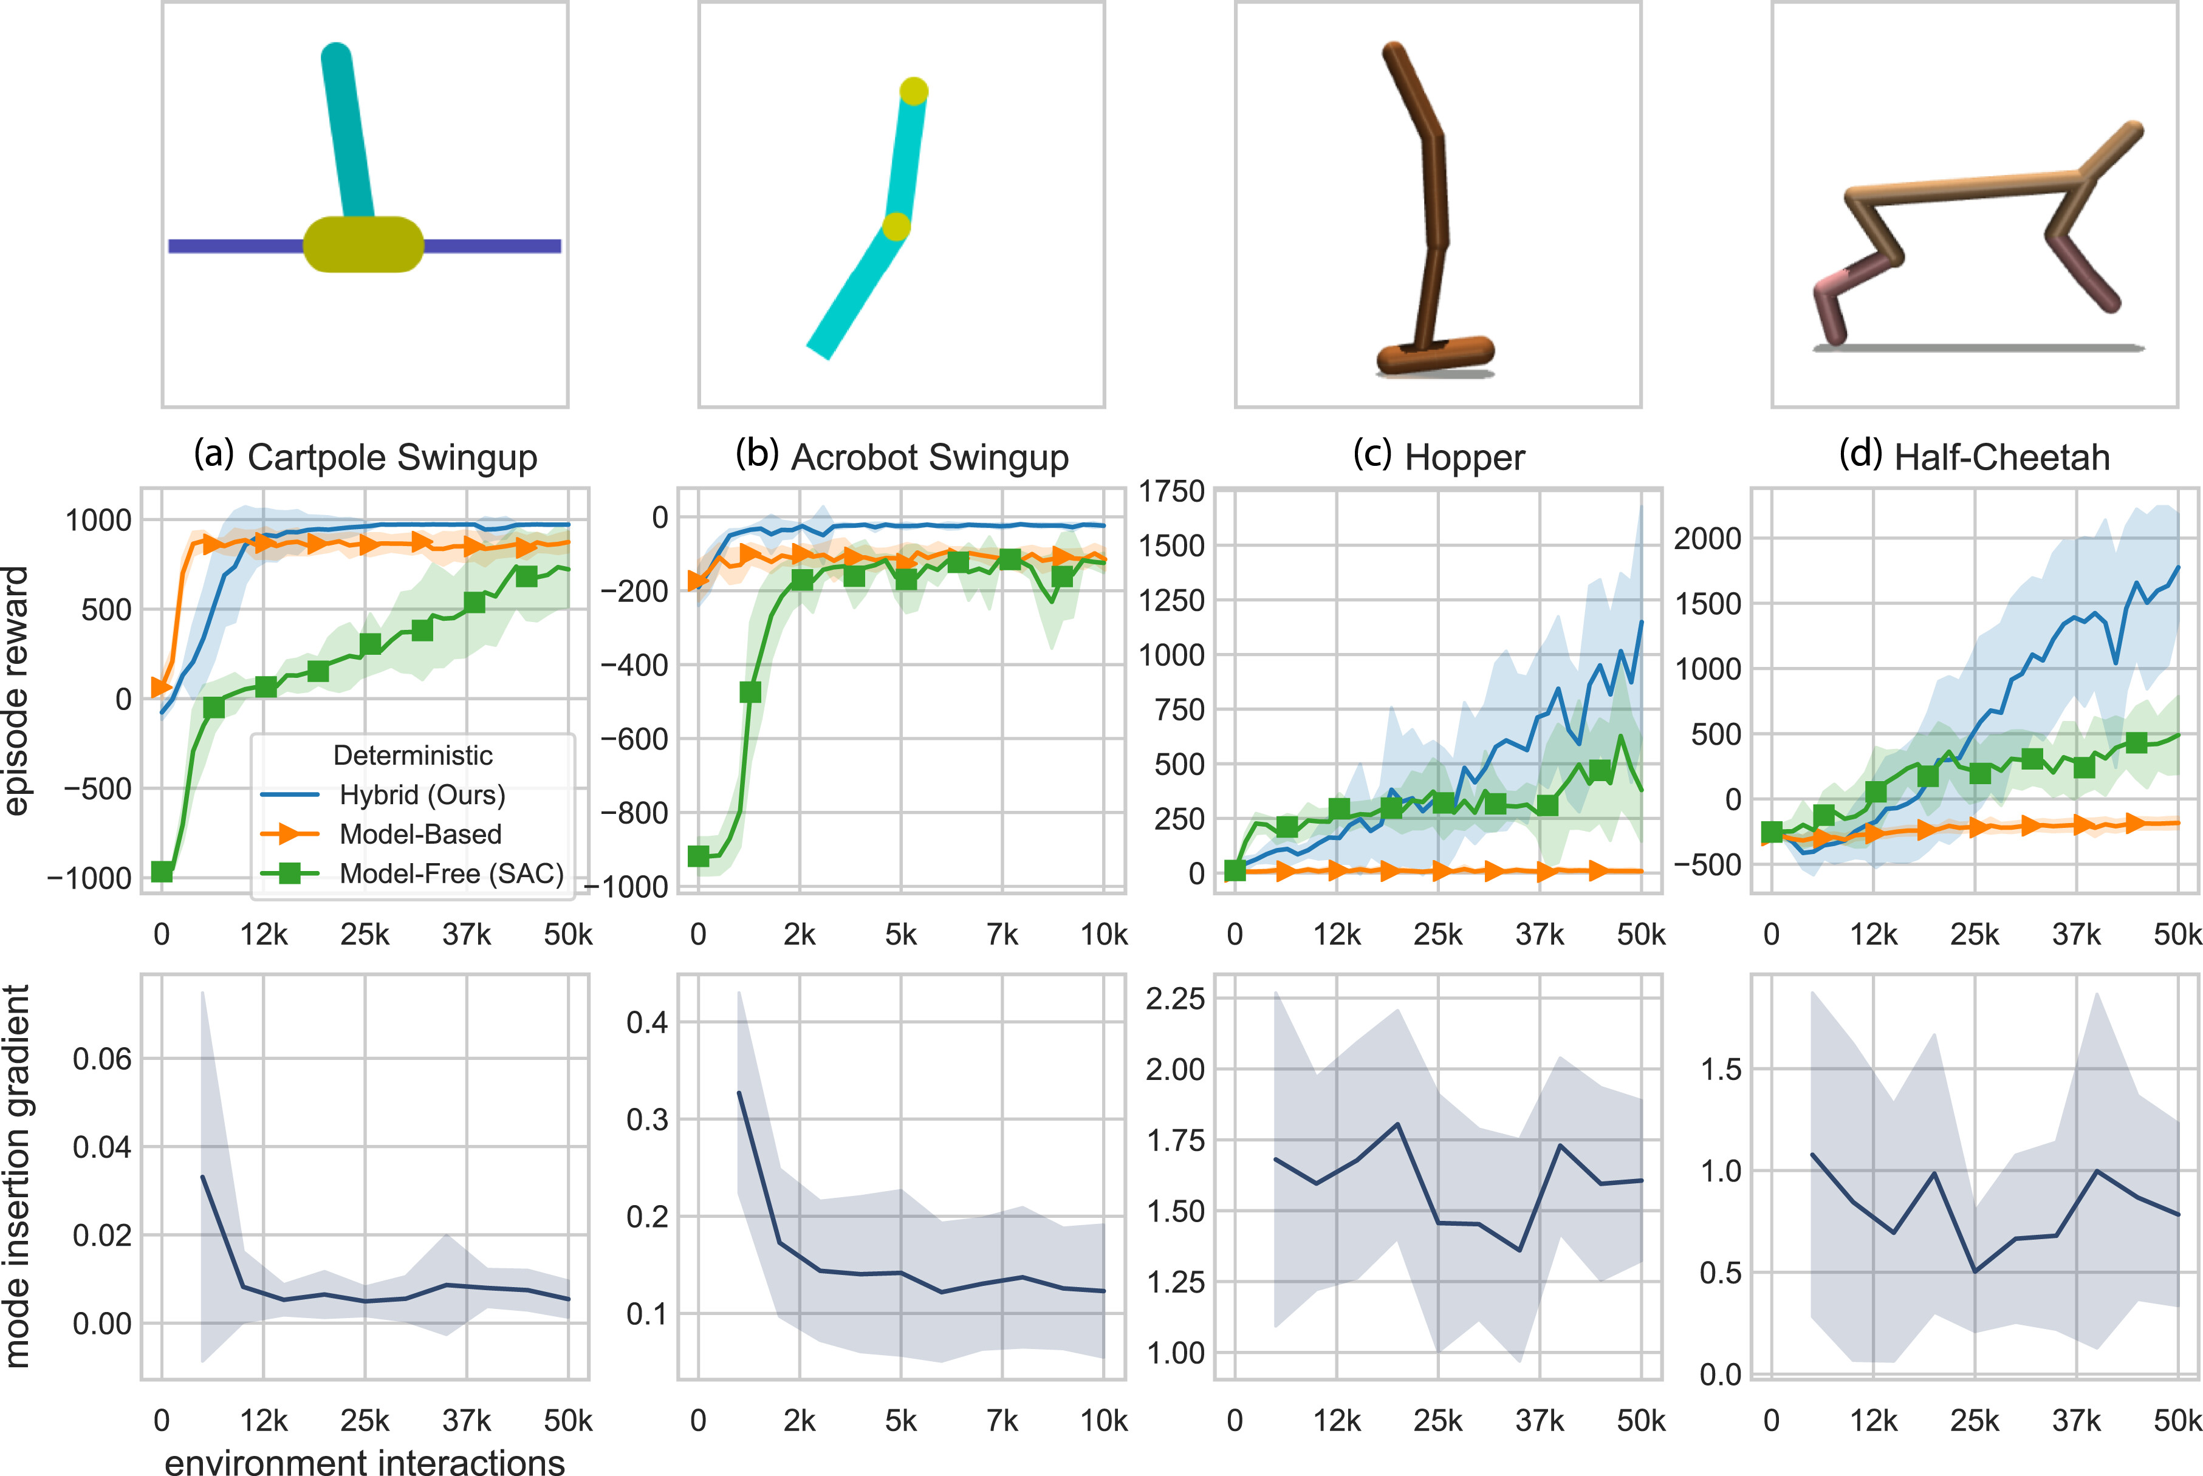
Conclusions and Future Directions
Summary:
Model-Based (planning, efficient) vs. Model-Free (simple, robust).
Future: Hybrid approaches combining both for optimal performance.
Reference: Sutton, R. S., & Barto, A. G. (2018). Reinforcement Learning: An Introduction, GFG articles.
Fig: The future of RL: Combining the best of both worlds.

Slide 12
Thank You

